Slide 1
Accelerated Reader
St. Mary’s Primary School

Slide 2
Purpose
The purpose of this presentation is to help improve attitudes and motivation in the area of reading for our pupils at home and in school.
Reinvigorate use and promotion of Accelerated Reader.

Slide 3
What we hope you discover about the accelerated reader programme
A clearer understanding of Accelerated Reading.
How Accelerated Reading is used in the school?
How your child is assigned a book?
What is expected from your child when they read an AR book?
How we are promoting reading in the school?
How you can help at home?

Slide 4
Some Stats - Literacy
Statistics from 2014 show that one in five children in the UK cannot read well by the age of 11.
Research conducted in 2012 found that 17% of 15 year-olds in the UK do not have a minimum level of proficiency in literacy.
16% of adults (around 5.8 million people) in England and Northern Ireland score at the lowest level of proficiency in literacy (at or below Level 1).

Slide 5
Reading for pleasure
In the UK children have less positive attitudes towards reading than in many other countries: only 26% of 10 year-olds 'like reading' (46% in Portugal, 42% in Georgia, 35% in Romania).
Most children in the UK do not read on a daily basis: in 2011 just over a third (37%) of 10 year-olds surveyed reported reading for pleasure every day.
In the UK, 36% of adults don't read for pleasure, rising to 44% of young people (aged 16 to 24).
41% of 11-15 year-olds in the UK do not participate in reading activities that are not required for school in their spare time.

Slide 6
Educational impacts of reading - research
Reading for pleasure is more important for children's cognitive development than their parents' level of education and is a more powerful factor in life achievement than socio-economic background.
There is a difference in reading performance equivalent to just over a year's schooling between young people who never read for enjoyment and those who read for up to 30 minutes per day.
Children who read books often at age 10 and more than once a week at age 16 gain higher results in maths, vocabulary and spelling tests at age 16 than those who read less regularly.

Slide 7
How do you judge a good reader?
Emergent Readers and Independent Readers

Slide 8
Osmosis
Definition
Colourful Picture ☺
Osmosis is the spontaneous net movement of solvent molecules through a semi-permeable membrane into a region of higher solute concentration, in the direction that tends to equalize the solute concentrations on the two sides.

Slide 9
Am I a good reader?
I read the words accurately
I read the sentences fluently EMERGENT READER
I read the words quickly
Did I understand what I’ve read?
Could I retell what I’ve read to someone? INDEPENDENT READER
Could I visualise (paint pictures) in my head what I was reading?

Slide 10
AR is designed to provide reading material of an appropriate content and difficulty level to allow optimal progress. AR allows more freedom to choose texts from within a given ability range. Learners are encouraged to achieve high levels of accuracy. Expected “pass marks” are typically set at 85% to ensure that a secure and deep understanding is achieved before attempting the next book level. By building this secure foundation, young learners are better equipped to develop their own ability and build the self-confidence to take more control of their learning.

Slide 11
Do not judge a book by it’s cover. AR judges content / comprehension.

Slide 12
These books are very different in word count and presentation but both are deemed 3.2 difficulty level. This is purely based on comprehension.

Slide 13
AR sorts texts into difficulty rating based on words used, sentence length and the complexity of paragraphs.

Slide 15
What we are doing in St. Mary’s to promote reading.
Daily silent reading – approximately 30minutes
Assigning books based on children’s STAR results
Allowing children time to complete AR quizzes
Reading Buddies (P7 and P1)
Monthly updates on results and in class updates on books read, word count and percentage success on reading comprehension
Certificates celebrating reading success, raffle tickets for words read, party for most successful reading gang
Book Fair Date TBC
Some classes working with Portaferry library R
Reading Logs

Slide 16
How much should my child read each day?
According to Renaissance Learning’s research, children who read at least 20 minutes a day with a 90% comprehension rate on AR quizzes see the greatest gains.
Therefore, your child should have at least 20 minutes set aside for reading during day.

Slide 17
How you can help your child to become a better reader
As with anything, performance improves with practice.
Encourage your child to read at home. Create a reading environment, devices off, TV off.
Create a culture of reading in your household by reading with your child, starting a home library, visiting your local library or bookshop on a regular basis and by letting your child see you reading.
When reading with your child stop and ask questions to be sure your child comprehends what they have read and in general make a habit of discussing books that each of you have read.

Slide 18
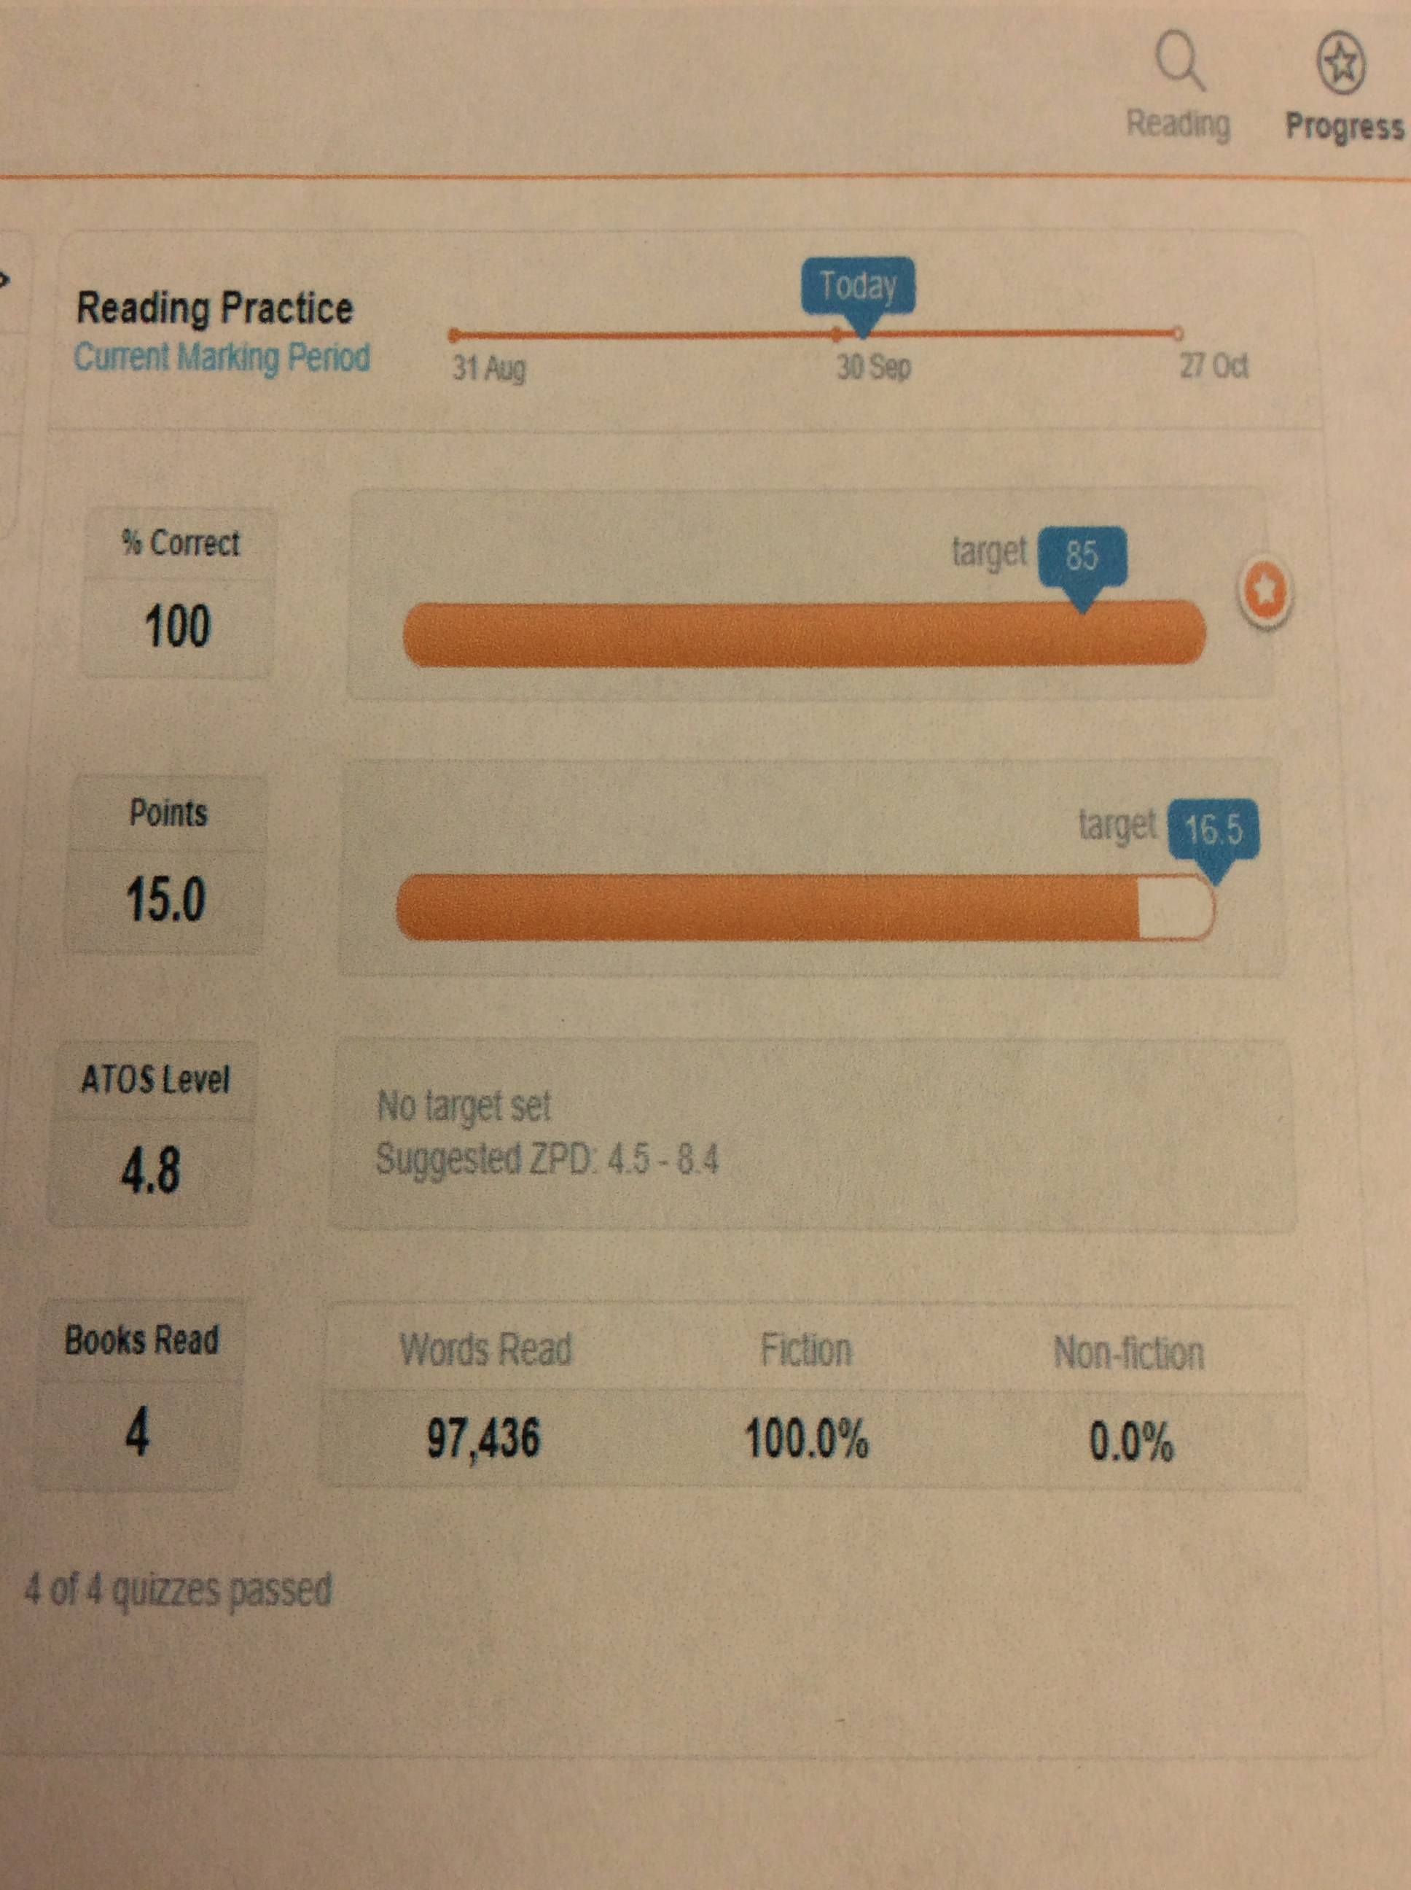

Slide 19
A final thought;
We must not ignore the importance of igniting a passion for reading in the next generation.
"In a world where the written word competes with so many other calls on our attention, we need more literacy heroes to keep inspiring young people to find the pleasure and power of reading for themselves."

